Slide 1
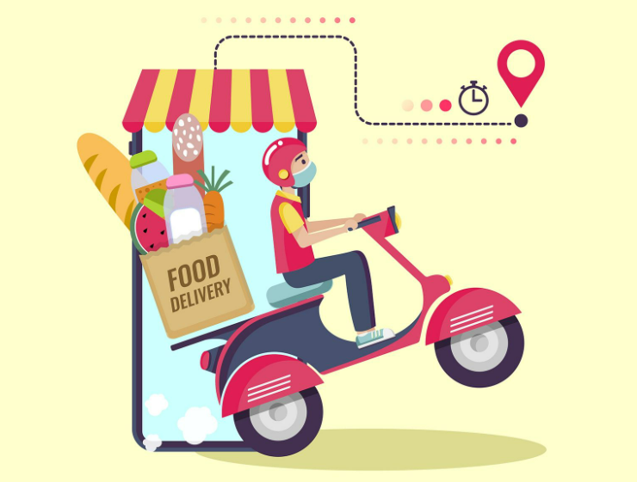
FOOD ORDERING MANAGEMENT SYSTEM

Slide 2
Group Members
T. ROHITH(2010030201)
A. ASHA SUSHMITA(2010030471)
B. CHOOSHNITA (20100300487)
B. SAI KOWSHIK GOUD(2010030558)

Slide 3
Index
Abstract
Introduction
What We Will Do
Software & Hardware Requirement
Modules
Advantages
Conclusion

Slide 4
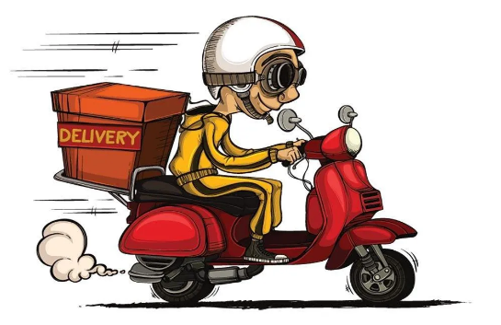
Abstract
ONLINE FOOD ORDERING SYSTEM is a website designed primarily for use in the food delivery industry.
This system will allow hotels and restaurants to increase scope of business by reducing the labor cost involvement.
The system also allows to quickly and easily manage an online menu.
Here , Customers can browse and use to place orders with just few clicks.
Graphical interface for efficient processing.

Slide 5
Introduction
Online ordering system that we are proposing here, greatly simplifies the ordering process for both the customer and the restaurant.
System presents an interactive and up-to-date menu with all available options in an easy to use manner.
Customer can choose one or more items to place an order which will land in the Cart.
Customer can view all the order details in the cart before checking out.
At the end, customer gets order confirmation details.
Once the order is placed it will be entered in the database and retrieved in pretty much real time .
This allows Restaurant Employees to quickly go through the orders as they are received and process all orders efficiently and effectively with minimal delays and confusion.

Slide 6
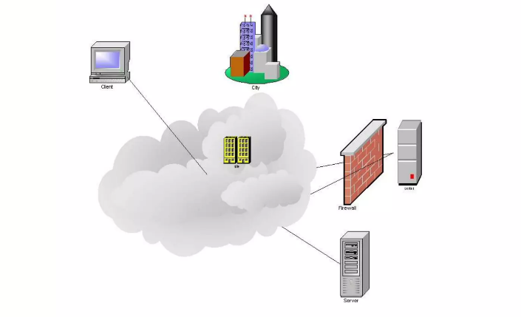
What We Will Do
Provide a display that will allow the customer to choose menu items and
make corrections.
Update this display with changes to the order.
Provide a running total cost and calories.
At order finalization, we will request identification information from the
customer.
Offer a static map of our surrounding area so that customers unfamiliar
with our location can find us.

Slide 7
Software & Hardware Requirement
Software Requirement:
Operating System : Windows 10 or 11
Front End : Java,JSP
Backend : servlet, my sql
Web Server : Tomcat
Hardware Requirement (Minimum):
Processor :PIV
RAM :512 Mb
Hard Disk : 10 GB Space

Slide 8
Modules
Customer Registration: This module will allow any customer to register in the website.
Customer Login: This module allow customer to login into the system.
Food Items Details : This module allow customer to see all the food items.
Cart: This module will show the selected items in this form.
Customer Order: This module will show the customer order form of the product.
Customer Order Confirmation: This module will be able to confirm order of cutomer.
Change Password: This module will allow customer to change his account password.
Cancelletion Order: This module allow customer to cancel the order within 15 mins if needed.

Slide 9
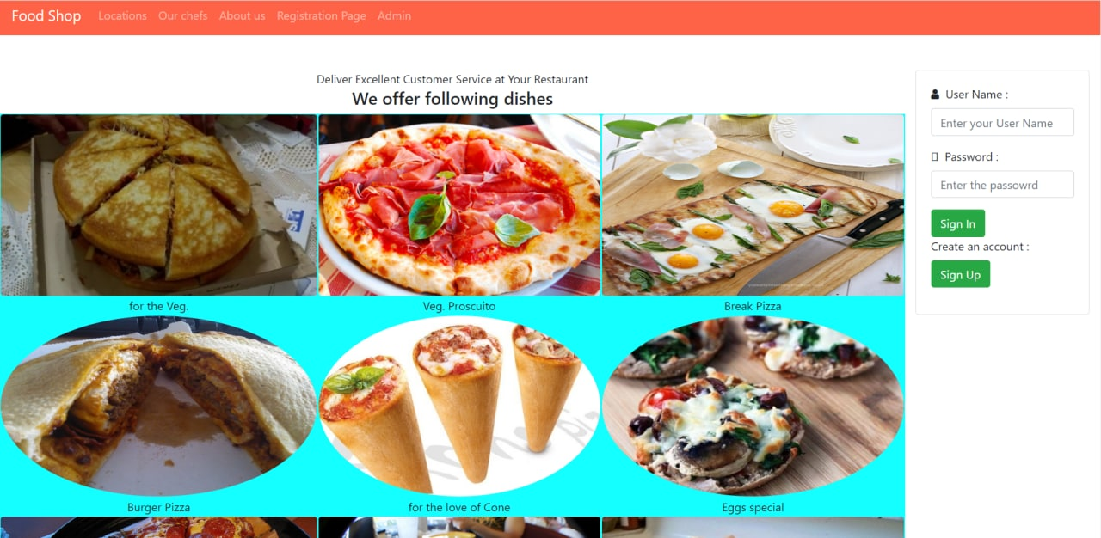
SAMPLE OUTPUTS

Slide 10
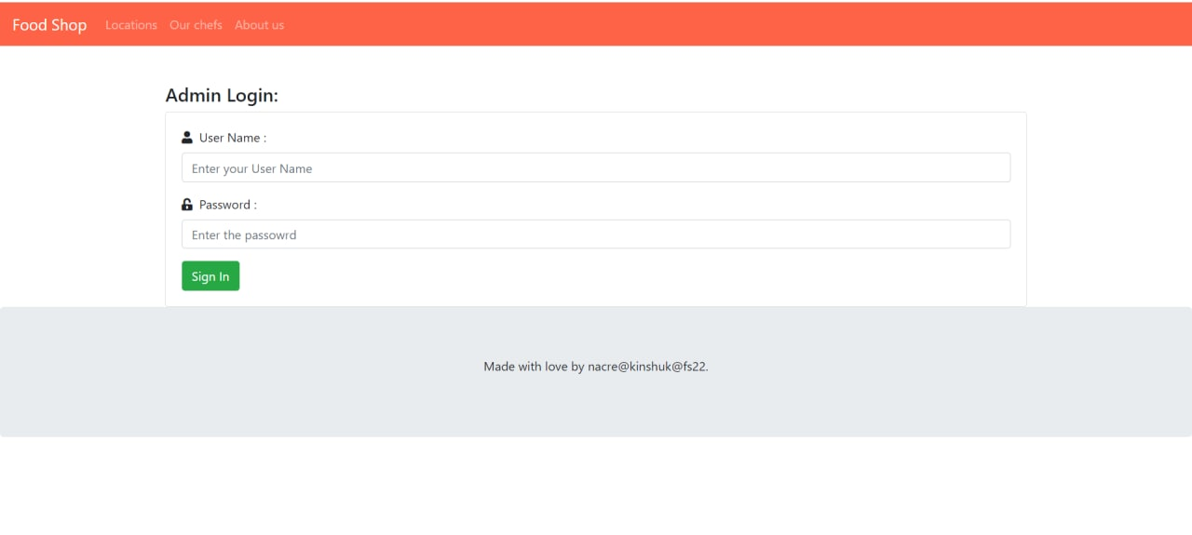

Slide 11
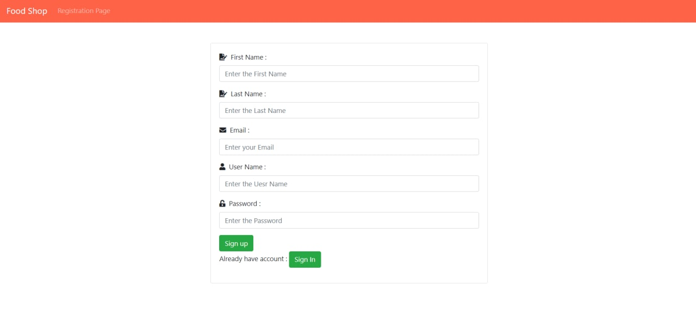

Slide 12
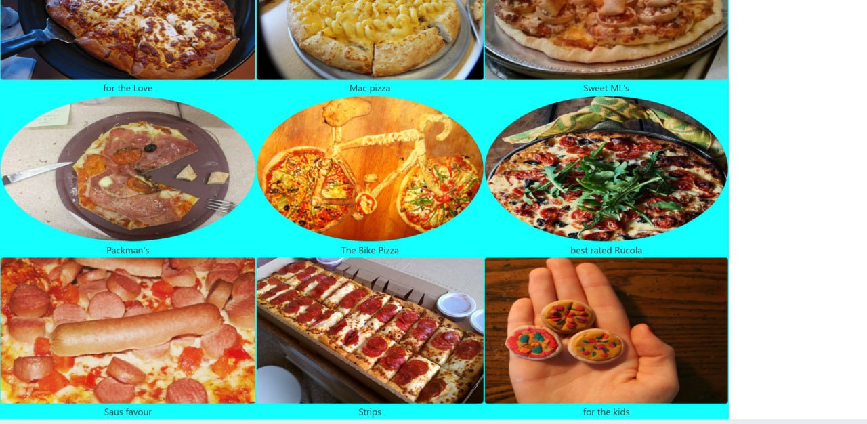

Slide 13
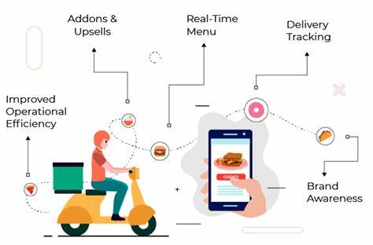
Advantages
Variety of Food
Convenience
Less Cost of Ad
Low Maintenance
Time-Savvy
Increase Loyalty
More Customers
Increase Visibility
Revamp Revenue
Wider Market

Slide 14
Conclusion
The core idea of a food delivery app is to provide a solution that does not require people to leave their homes, even on ordinary days, to avail of their services.
The system gives them the facility to stay in the comfort and safety of their homes and avail everything that they need in just a few clicks.

Slide 15


